Slide 1

AI Agents using Microsoft Agent Framework

Slide 2
Presenters

Slide 3

Contents
01
05
Microsoft Foundry
Summary
Contents
02
06
Microsoft Agent Framework
Hands-on Labs
03
07
MCP (Model Context Protocol)
Q & A
08
04
Conclusion
AI Agents and Agent Framework Workflows

Slide 4
Introduction to Microsoft Foundry

Slide 5
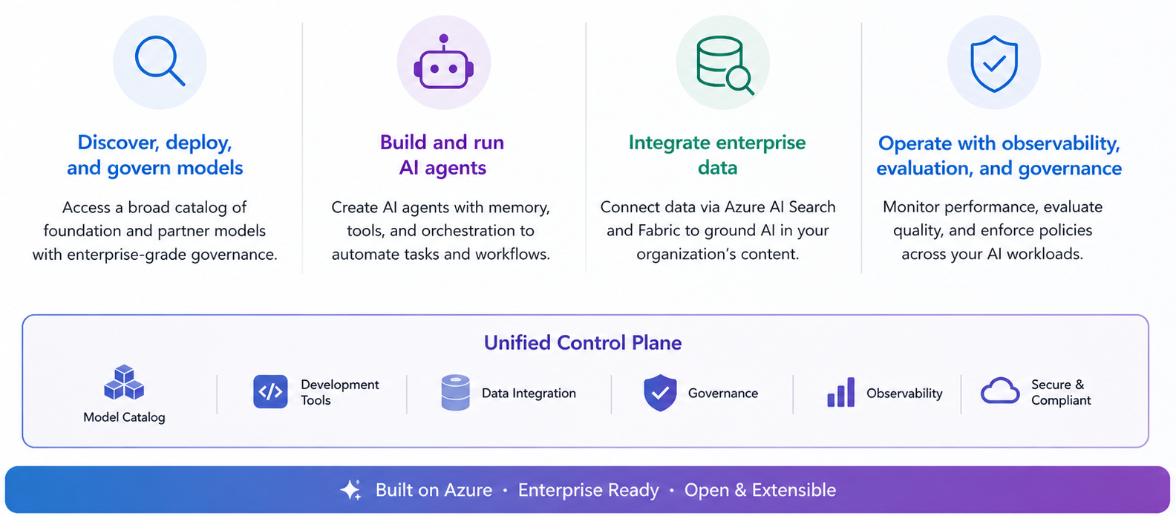
Microsoft Foundry Overview
Microsoft Foundry is Microsoft’s enterprise AI app and agent factory, providing a unified control plane to:
Notes:
Microsoft Foundry acts as a single, unified control plane for building, deploying, and governing AI applications and agents. It rests on four pillars: discovering, deploying, and governing models from a broad catalog with enterprise-grade governance; building and running AI agents with memory, tools, and orchestration; integrating enterprise data through Azure AI Search and Microsoft Fabric; and operating with observability, evaluation, and governance across AI workloads. All of this sits on a unified control plane spanning the model catalog, development tools, data integration, and governance — built on Azure and designed to be open and extensible.

Slide 6

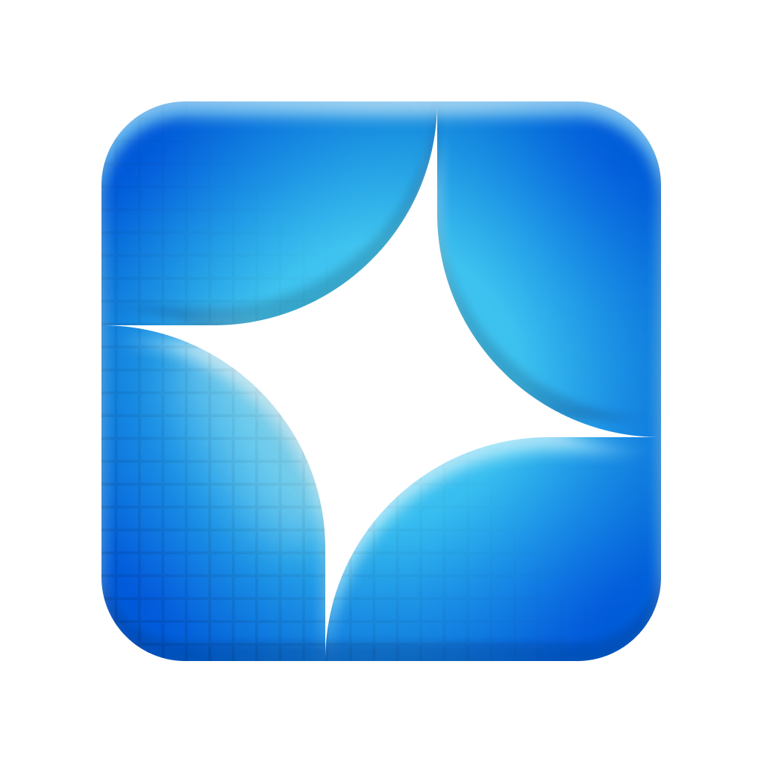




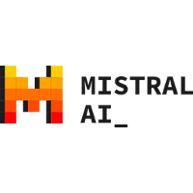
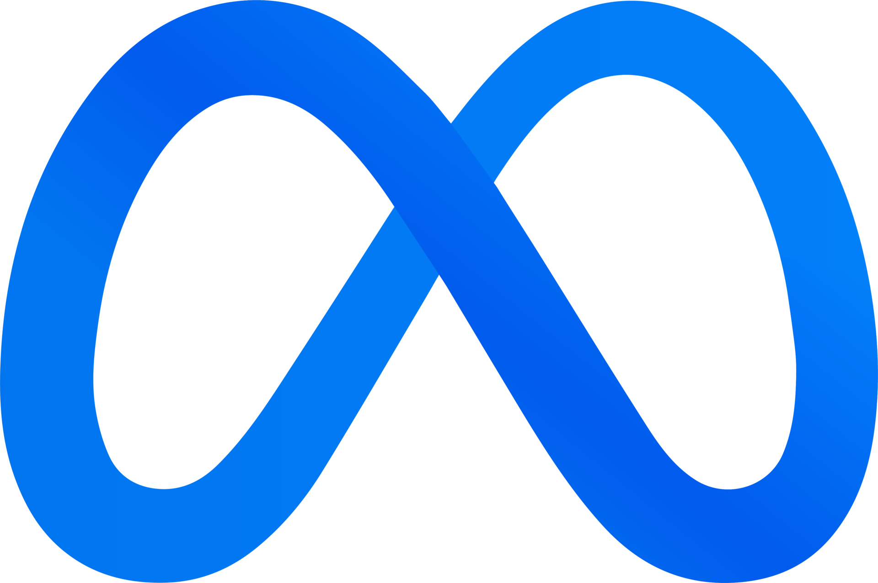




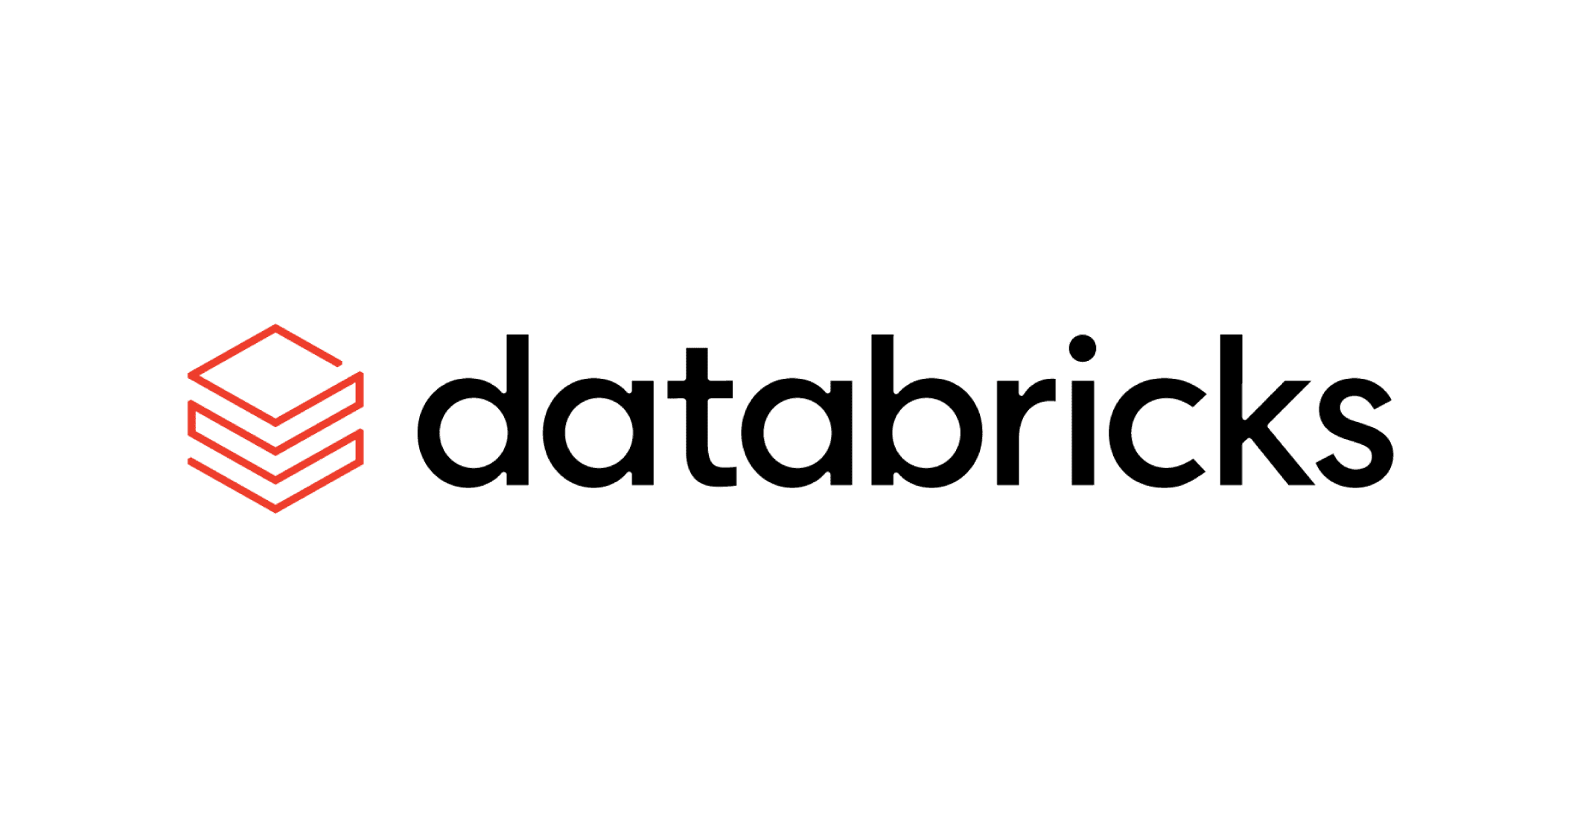




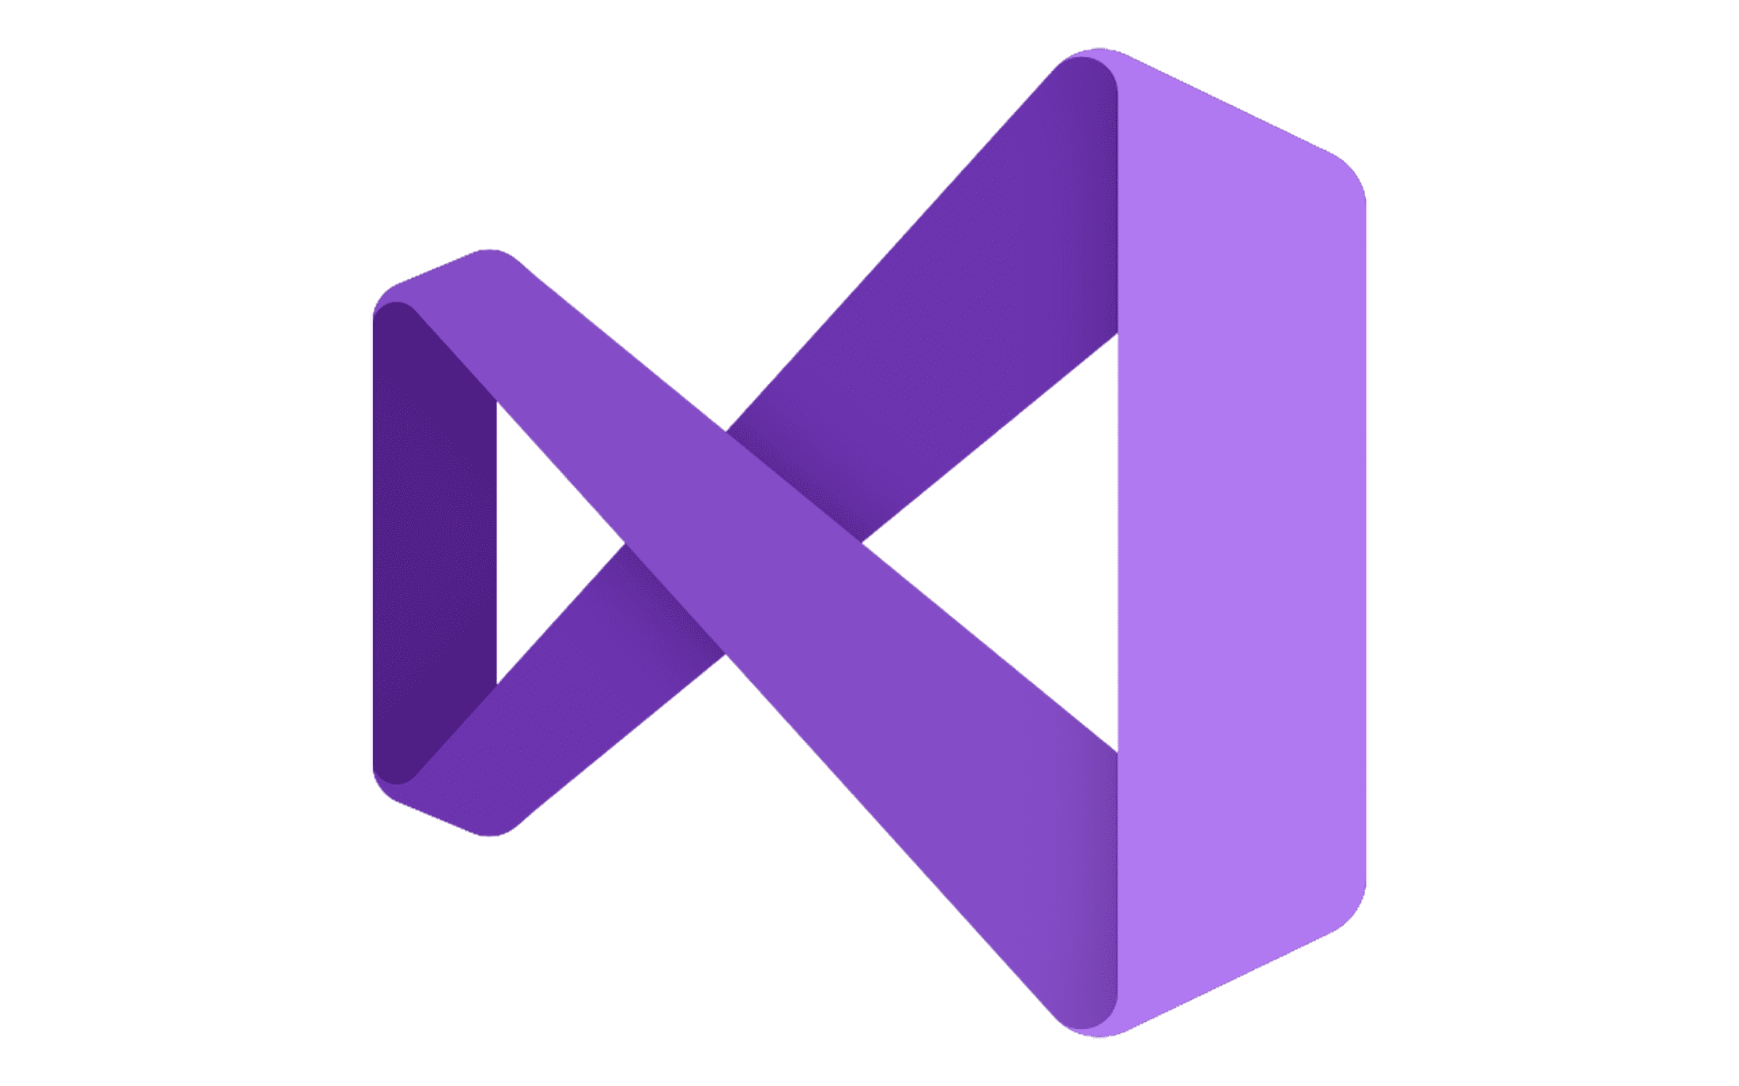
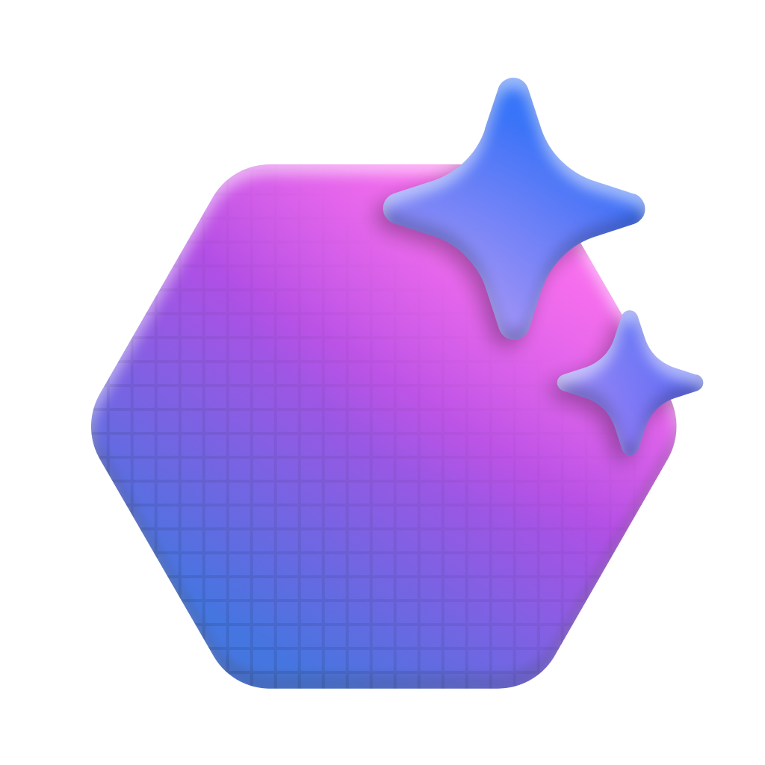



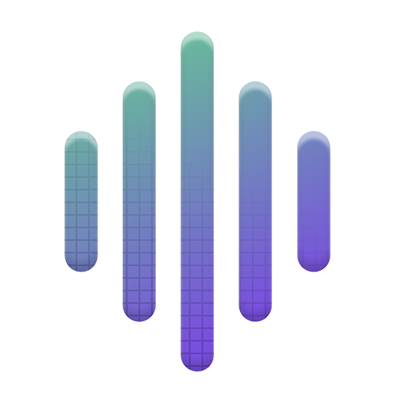
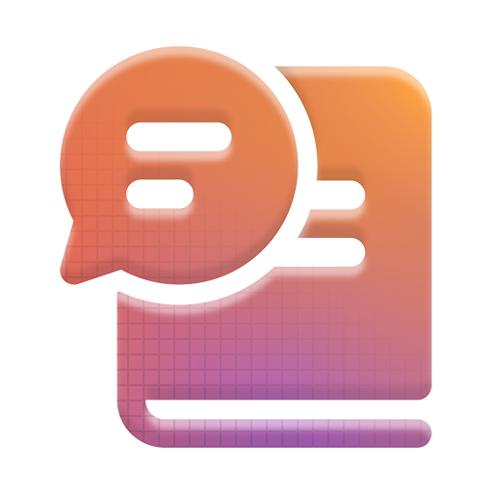
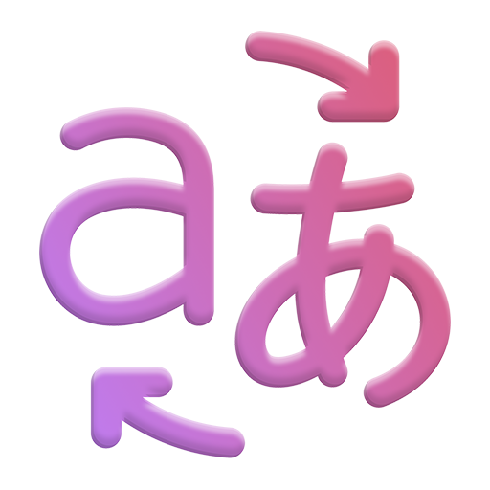
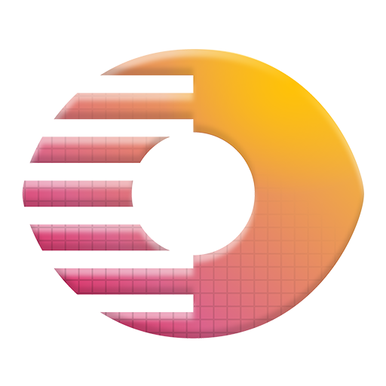
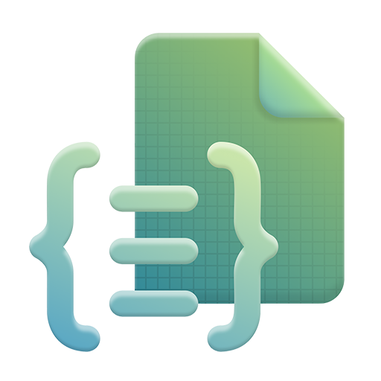









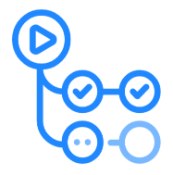

Microsoft Foundry Ecosystem
Design with the best models
 | Foundry Models |  | Phi models |  | Jais G42 models |  | Snowflake models |  | Hugging Face models |  | Mistral AI models |  | Meta Llama models |  | Rockwell |  | Bayer
 | Cohere models |  | Databricks models |  | NVIDIA models |  | Deci AI models |  | Nixtla TimeGen1 |  | NTT DATA model |  | Sight Machine |  | Saifr |  | DeepSeek
Copilot
Studio
Customize with a comprehensive agent toolchain
1P offerings |  |  |  |  |  |  |  |  |  |  |  |  |  | 3P offerings
 | Microsoft Foundry Agent Service |  | Azure AI Search |  | Microsoft Fabric |  | Azure SQL Database |  | Microsoft Bing |  | Azure Blob Storage |  | Microsoft SharePoint |  | LangChain |  | LlamaIndex
 | Azure Managed Redis |  | Azure Cosmos DB |  | Azure Data Lake Storage Gen2 |  | Azure Logic Apps |  | Azure Functions |  | Azure Event Hubs |  | Azure Container Apps dynamic sessions |  | Llama Stack |  | Code Interpreter
 | Azure Container Apps |  | Azure Kubernetes Service (AKS) |  | Azure Speech |  | Azure Language |  | Azure Translator |  | Azure Vision |  | Azure Document Intelligence |  | OpenAI Actions |  | Gretel
 | Azure Content Understanding |  | Semantic Kernel |  | AutoGen |  | Azure Machine Learning |  | Prompty |  | Fine-tuning & distillation |  | Tracing & debugging |  | Weights & Biases |  | Scale
 | Evaluation |  | Experiments |  |  |  |  |  |  |  |  |  |  |  | Statsig |  | Arize AI
Visual
Studio
GitHub
Manage performance in production
 | Azure Monitor |  | Azure App Configuration |  | Microsoft Cost Management |  | ClearML |  | Dataloop |  | GitHub Actions
Foundry SDK
Safeguard with Trustworthy AI
 | Azure AI Content Safety |  | Microsoft Defender for Cloud |  | Microsoft Entra ID |  | Azure Policy |  | Azure Application Gateway |  | Azure Confidential Computing |  | Azure Backup
Note: AutoGen is now in maintenance mode (bug fixes and security patches only); Semantic Kernel and AutoGen capabilities are being consolidated into Microsoft Agent Framework going forward.
Notes:
Foundry is not a single portal but an ecosystem reachable through several entry points: Copilot Studio for low-code makers, Visual Studio and GitHub for developers, and the Foundry SDK for programmatic control. Its capabilities span a full lifecycle — designing with the best models, customizing with a comprehensive agent toolchain, managing performance in production, and safeguarding with Trustworthy AI. As of Agent Framework 1.0, AutoGen is in maintenance mode and Semantic Kernel's agent capabilities are being consolidated into Microsoft Agent Framework going forward.

Slide 7
Microsoft Foundry Resource & Project
A unified platform for AI apps and agents
What Foundry provides
Azure resources for apps and agents
Foundry resources provide compute, storage, model delivery, and other services.
Foundry projects are isolated work environments for app and agent development.
In a project, teams work with models, agents, tools, and knowledge.
Together, these building blocks help agents reason, act, and use approved information.
Microsoft Foundry resource
Project-level building blocks
Microsoft Foundry project
Models
Choose and deploy models from the catalog.
Agents
Create and manage agents that reason with models.
Tools
Connect actions and external information.
Knowledge
Manage data source access for grounding.
Notes:
A Foundry resource is the underlying Azure resource supplying compute, storage, and model delivery, while a Foundry project is an isolated working environment created inside it. Within a project, teams combine four building blocks — models, agents, tools, and knowledge — which together let an agent reason, act, and stay within approved boundaries. Access control and quotas are managed at the resource level, so platform teams keep governance while product teams keep moving fast.

Slide 8
Foundry Models
One place to discover, evaluate, and deploy 11,000+ AI models, with 50 new models published every month from Microsoft, OpenAI, Anthropic, Meta, DeepSeek, Hugging Face, Mistral, and more.
Models sold by Azure
Azure Direct Models - hosted & sold by Microsoft
All Microsoft Foundry models plus select top providers
Enterprise SLAs, deep Azure integration, Microsoft support
Billed through your Azure subscription
Models from partners & community
Non-Microsoft models from partners, labs & community
Anthropic, Cohere, Mistral, Meta, NVIDIA, and more
Deployed through Azure Marketplace
Providers set license terms and pricing
11,000+ models
Discover & compare side-by-side
Flexible deployment
Standard, managed compute, or instant
Fine-tuning
Customize with your own data
Responsible AI
Built-in safety & observability
Notes:
Microsoft Foundry provides one place to discover, evaluate, and deploy over 11,000 AI models, with roughly 50 new models published every month from providers such as Microsoft, OpenAI, Anthropic, Meta, DeepSeek, Hugging Face, and Mistral. Models sold directly by Azure come with Microsoft billing, enterprise SLAs, and support, while partner and community models are hosted under their own provider's terms. Model choice is best treated as a reversible decision: standardize the agent's contract first, then swap the underlying model as cost and capability needs change.

Slide 9
Microsoft Agent Framework

Slide 10
The Microsoft Agent Framework
A framework for building interactive, robust, and safe AI applications. It offers three primary categories of capabilities, built on a set of foundational building blocks.
Agents
Harness
Workflows
Individual agents that use LLMs to process inputs, call tools and MCP servers, and generate responses.
Supports Microsoft Foundry, Anthropic, Azure OpenAI, OpenAI, Ollama, and more.
An opinionated agent with batteries-included capabilities for long, multi-step tasks:
Planning and to-do tracking
Context compaction, file access, and memory
Tool approval and observability
Graph-based workflows that connect agents and functions for multi-step tasks, with:
Type-safe routing
Checkpointing
Human-in-the-loop support
Foundational building blocks: model clients (chat completions and responses), an agent session for state management, context providers for memory, middleware for intercepting actions, and MCP clients for tool integration.
Notes:
Microsoft Agent Framework consolidates the capabilities of Semantic Kernel and AutoGen into a single, supported programming model for building interactive, robust, and safe AI applications. It offers three categories of capability: Agents, individual reasoning entities that call tools and models; Workflows, which orchestrate agents and functions deterministically; and a shared set of foundational building blocks — model clients, sessions, context providers, middleware, and MCP clients. Retries, approvals, and observability are first-class features of the framework, not optional add-ons.

Slide 11
What Are Agents?
In the Microsoft Agent Framework, an agent is an individual entity that uses a large language model (LLM) to process inputs, call tools and MCP servers, and generate responses — working on its own or alongside other agents and humans.
What an Agent Does
Foundational Building Blocks
Uses an LLM to process inputs and reason over them
Calls tools and MCP servers to take action
Generates responses to complete the task
Works autonomously or with other agents and humans
Model clients — connect to the LLM (chat & responses)
Agent session — manages state across a conversation
Context providers — give the agent memory
Middleware — intercepts agent actions
MCP clients — integrate external tools
Works across model providers including Microsoft Foundry, Azure OpenAI, OpenAI, Anthropic, and Ollama
Notes:
An agent is an entity that uses a large language model to process input, reason over it, and decide whether to call tools or MCP servers before producing a response, either independently or alongside other agents and humans. This differs from a plain chat completion call because an agent owns its instructions, tool access, and memory across turns, letting it take action rather than only answer. The framework's five building blocks — model clients, sessions, context providers, middleware, and MCP clients — give an agent everything it needs to connect, remember, and act. A well-scoped, narrow agent generally outperforms one large agent juggling many tools.

Slide 12
What Are Workflows?
Microsoft Agent Framework Workflows let you build intelligent automation that blends AI agents with business processes, using a type-safe, graph-based architecture to orchestrate complex processes with explicit control over the execution path.
Workflow
Workflow APIs
A predefined sequence of operations that can include AI agents as components. The flow is explicitly defined, handling:
Complex, multi-agent business processes
Human interactions and approvals
Integrations with external systems
Two complementary APIs, both fully supported with the same observable results:
Functional API — async Python functions using @workflow and @step (experimental)
Workflow Builder — directed graphs of executors and edges for fixed topologies
Both support events, streaming, human-in-the-loop, and checkpoints
Key features: type safety, flexible graph-based control flow, external and human-in-the-loop integration, checkpointing for recovery, and multi-agent orchestration (sequential, concurrent, hand-off, and magentic).
Notes:
Agent Framework Workflows let developers blend AI agents with business processes using a type-safe, graph-based architecture, where executors act as nodes and typed messages travel along edges as explicit control flow. Because the execution path is explicit rather than left to a model's judgment, workflows stay auditable, resumable, and testable. Two APIs are available: an experimental functional API using @workflow/@step decorators, and the more established Workflow Builder for constructing directed graphs. Both support events, streaming, human-in-the-loop steps, and checkpointing.

Slide 13
Workflow Orchestrations
Agent Framework provides several built-in multi-agent orchestration patterns — reusable coordination models that sit above the workflow graph and return ordinary workflows you can run, stream, and compose.
Sequential
Concurrent
Handoff
Group Chat
Magentic
Agents execute one after another in a defined order, each building on the previous output.
Agents run in parallel on the same task, and their results are collected and aggregated.
Agents transfer control to one another based on context, routing work to the right specialist.
Agents collaborate together in a shared conversation to reach a joint result.
A manager agent dynamically plans, assigns, and coordinates a team of specialized agents.
Human-in-the-loop: Orchestrations pause for human review through approval-required tools and request-info, keeping people in control before critical actions run.
Notes:
Agent Framework ships with five built-in orchestration patterns that each return an ordinary, runnable workflow: Sequential (agents run one after another), Concurrent (agents run in parallel and results are aggregated), Handoff (agents transfer control based on context), Group Chat (agents collaborate in a shared conversation), and Magentic (a manager agent dynamically plans and coordinates specialists). The right pattern depends on the problem — pipelines suit sequential, fan-out tasks suit concurrent, routing suits handoff, and open-ended planning suits magentic. Because each returns a standard workflow, these patterns can be nested inside larger processes.

Slide 14
MCP (Model Context Protocol)
Notes:
Faisal To take over from here

Slide 15
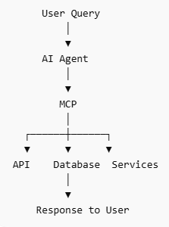
MCP(Model Context Protocol)
MCP (Model Context Protocol) enables AI agents to connect with external tools and services. It acts as a standard interface between agents and APIs. Agents can use MCP to fetch real-time data, trigger actions, and extend capabilities. MCP tools are invoked dynamically based on user queries and agent reasoning. It supports seamless integration with HTTP-based services and enterprise systems
How MCP Integration Works
The user sends a request to the AI agent.
The agent identifies if external data or action is needed.
The agent uses MCP to call the required tool (API, database, etc.).
MCP returns the response/data back to the agent.
The agent processes it and sends the final response to the user.
Notes:
MCP acts as a standard interface between AI agents and external tools or services — one open protocol lets any MCP-capable agent discover and call external tools, APIs, and enterprise systems without custom integration code for each one. An agent connects to an MCP server, the server advertises the tools and schemas it exposes, the agent selects and calls the right tool, and the server executes it and returns structured results. This enables reuse and centralized governance, since one MCP server can serve many agents while permissions are enforced at the server rather than scattered across prompts.

Slide 16
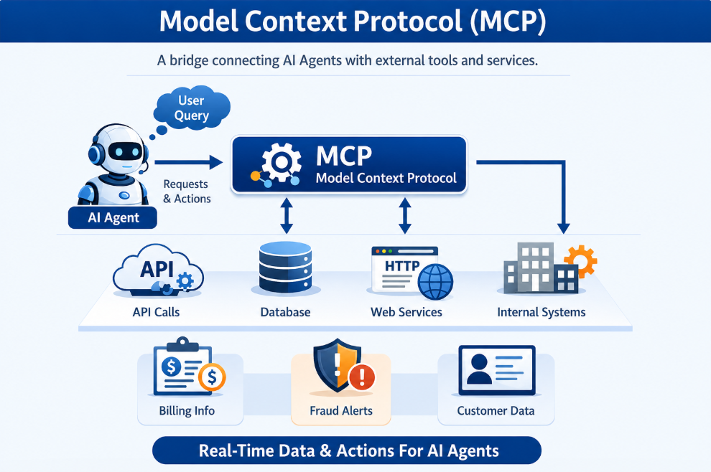
MCP (Model Context Protocol)
Notes:
Frame MCP as the USB-C of agent tooling: one open protocol so agents can discover and call external tools, APIs and enterprise systems without bespoke glue code per integration. Walk the flow the agent connects to an MCP server, the server advertises its tools and schemas, the agent selects a tool, the server executes it and returns structured results. The payoff is reuse and governance: one MCP server can serve many agents, and permissions are enforced at the server rather than scattered in prompts.

Slide 17
Introduction to AI Agents and Agent Framework Workflows

Slide 18
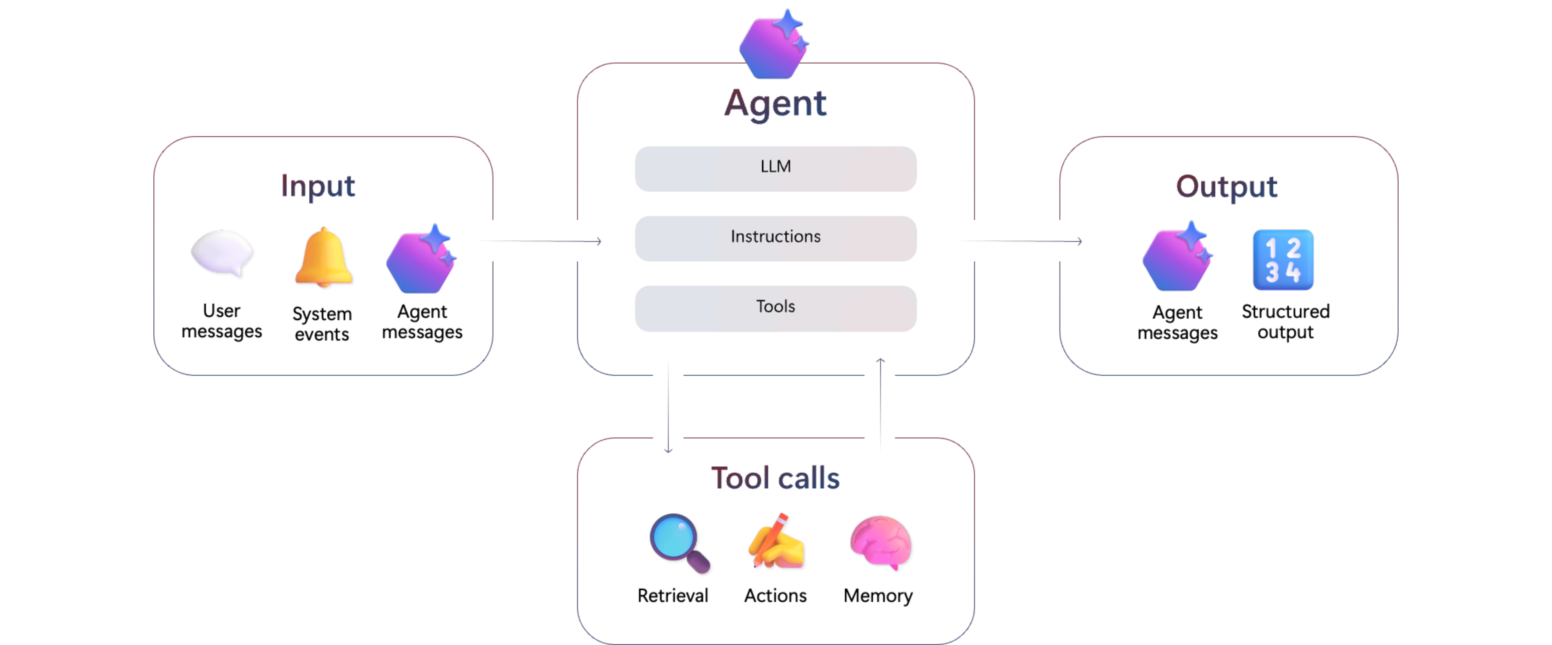
AI Agents
Agents are intelligent components that can make decisions, trigger tools, and participate in workflows - either on their own or in collaboration with other agents or humans. They analyze inputs, choose actions, and carry out tasks such as calling APIs or processing data. This allows them to support both simple automations and more complex, multi-step processes across a variety of applications.
Each agent has three core components:
Model (LLM): Powers reasoning and language understanding
Instructions: Defines the agent’s goals, behavior, and constraints
Tools: Lets the agent retrieve knowledge or take action
Notes:
Every agent is built from three core components: a model, which powers reasoning and language understanding; instructions, which define its goals, behavior, and constraints; and tools, which let it retrieve knowledge or take action. Agents analyze inputs, choose actions, and carry out tasks such as calling APIs or processing data, supporting both simple automations and complex multi-step processes. Because most quality problems trace back to how instructions are written, treating instructions and tool definitions as versioned artifacts, reviewed like code, helps maintain quality over time.

Slide 19
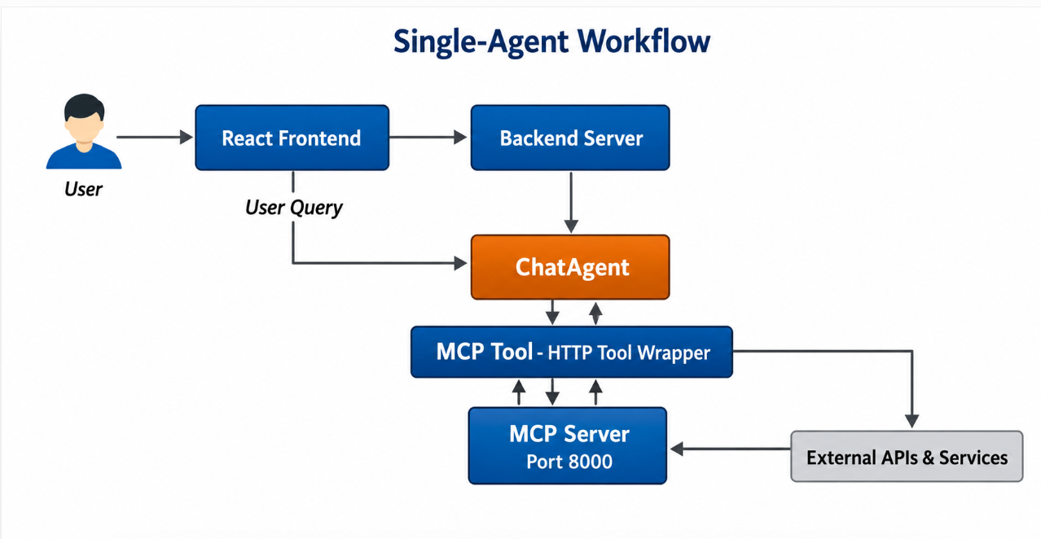
Single-Agent Workflow
A Single-Agent Workflow is an AI system where one autonomous agent uses a single Large Language Model (LLM) to handle a task end-to-end, including planning, tool usage, memory, and reasoning.
A single Chat Agent handles the entire user request.
The user interacts through the frontend and backend.
The agent decides when to call external tools via the MCP server.
Tool responses are combined with AI reasoning to generate the final answer.
Notes:
A single-agent workflow is a system where one autonomous agent uses a single LLM to handle a task end-to-end, including planning, tool usage, memory, and reasoning. A user request passes through the frontend and backend to one chat agent, which decides when to call external tools via an MCP server and combines the results with its own reasoning to produce a final answer. This is the recommended starting point for most projects, since it's easier to test, cheaper to run, and simpler to debug than a multi-agent system — a move to multiple agents is only warranted once a real limitation is hit.

Slide 20
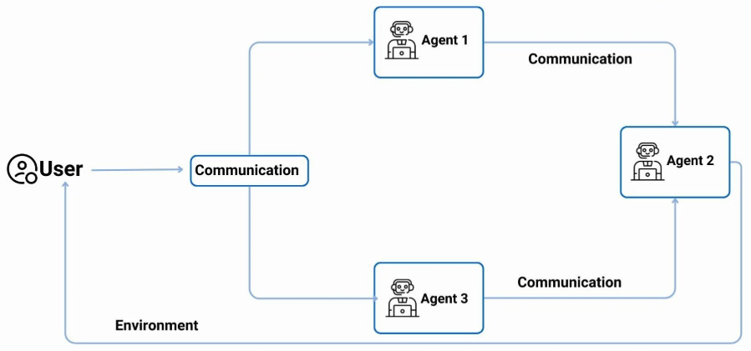
Multi-Agent Systems
Multi-Agent Systems are composed of independent entities (agents) that cooperatively or competitively perform for given goals. Every agent is autonomous and has decision-making and action executing capabilities whiles working towards the achievement of these global goals.
Top use cases:
Customer Support: Multiple agents classify issues, fetch solutions, and automate ticket resolution.
Financial Reporting: Agents gather data, analyze trends, and generate automated reports.
Healthcare Diagnostics: Agents retrieve patient data, suggest diagnoses, and check treatment compliance.
Notes:
A multi-agent system is composed of independent, autonomous agents that cooperate or compete toward a shared goal, each with its own decision-making and ability to act. Typical use cases include customer support (classifying issues and resolving tickets), financial reporting (gathering data and generating reports), and healthcare diagnostics (retrieving patient data and checking treatment compliance). The benefit is specialization — smaller instruction sets and clearer evaluation per agent — at the cost of more moving parts, meaning higher latency and more complex debugging.

Slide 21
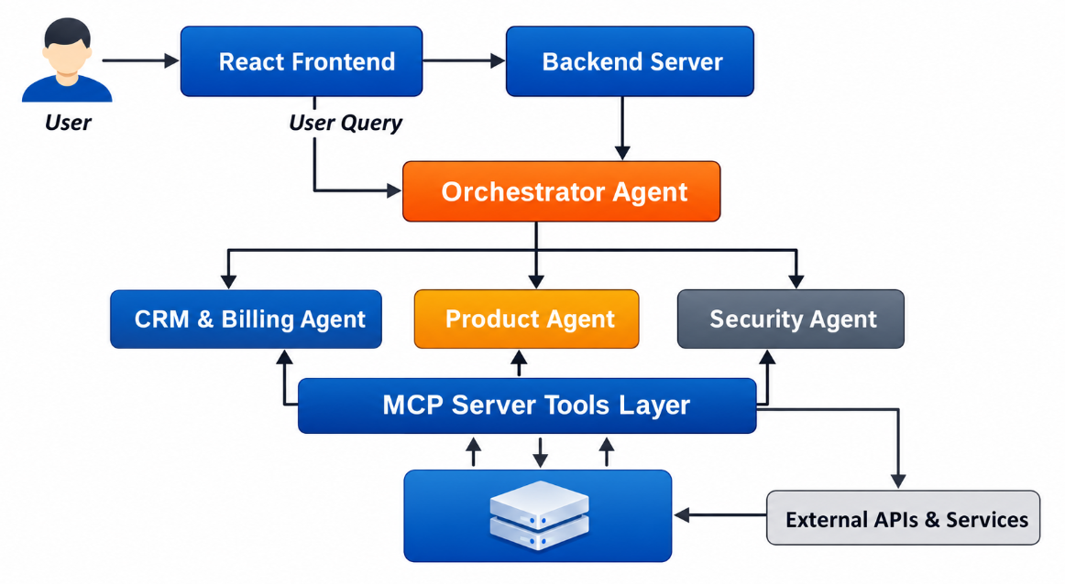
Multi-Agent (Orchestrator Pattern)
The Multi-Agent Orchestrator pattern is an AI architecture where a central "manager" agent (the orchestrator) coordinates specialized, autonomous AI agents to solve complex tasks.
A central Orchestrator Agent receives the user query.
It analyzes the request and routes it to the appropriate specialized agent.
Each agent handles a specific domain (Billing, Product, Security).
Agents use tools via the MCP server and return results to the orchestrator.
Notes:
A central manager agent — the orchestrator — receives the user query, analyzes it, and routes it to the appropriate specialized agent, such as Billing, Product, or Security. Each specialist uses tools through the MCP server and returns results to the orchestrator, which assembles the final answer. The main strength is control, since the orchestrator is a single place to enforce sequencing, budgets, and quality checks; keeping specialists stateless while the orchestrator owns shared context prevents agents from drifting out of sync.

Slide 22
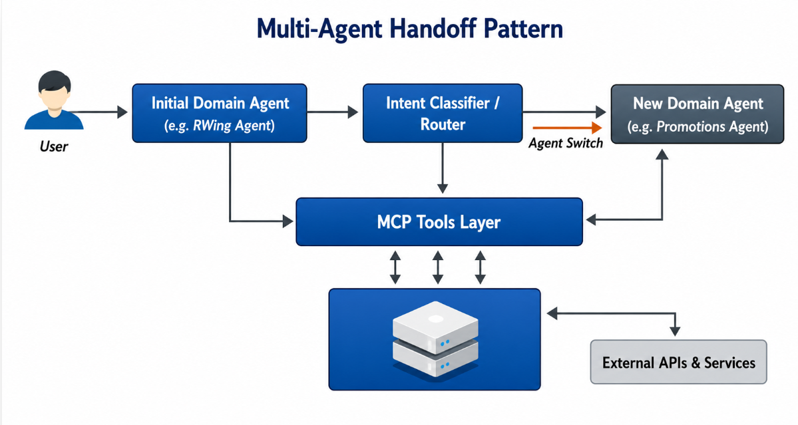
Multi-Agent (Handoff Pattern)
The Multi-Agent Handoff pattern is a design where specialized AI agents dynamically transfer control, task responsibility, and conversation context to one another based on user intent
The user interacts directly with a domain-specific agent.
An intent classifier detects if the query belongs to another domain.
If needed, the conversation is handed off to another agent.
Context is transferred so the new agent continues seamlessly.
Notes:
In the handoff pattern there is no central manager — specialized agents dynamically transfer control, task ownership, and conversation context to one another based on detected user intent. This suits conversational scenarios where the user's need shifts mid-dialogue, such as moving from billing to technical support. Handoff is generally cheaper and more natural for chat, while orchestration is better when a guaranteed sequence and aggregated results are required.

Slide 23
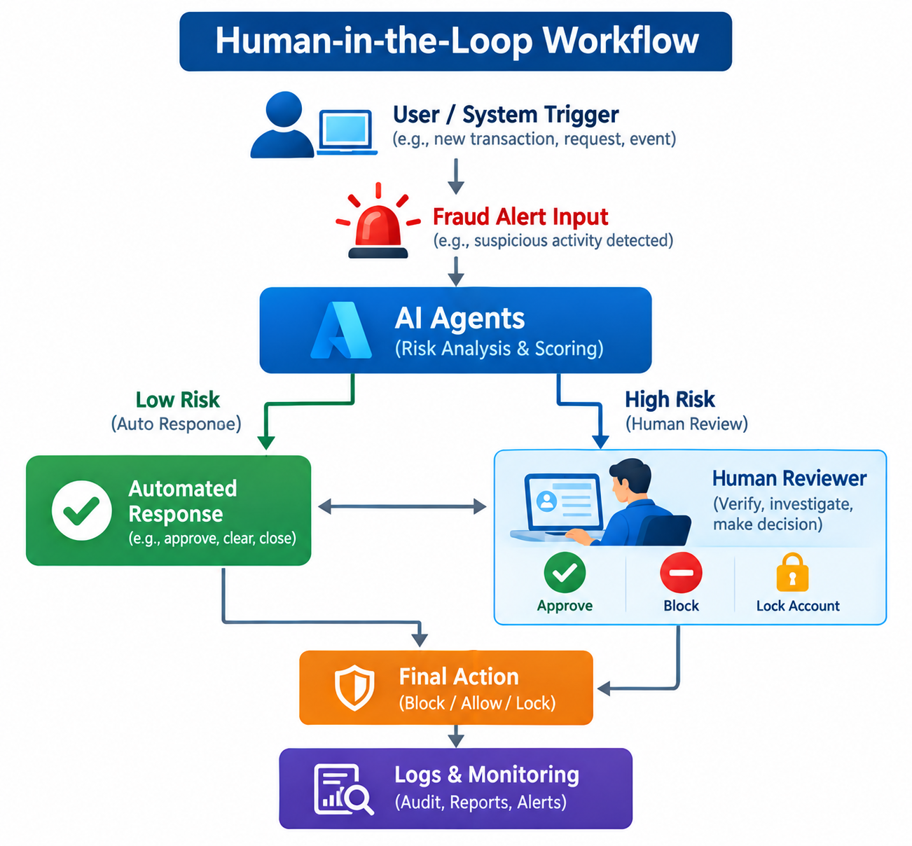
Human-in-the-Loop Workflow
Microsoft Agent Framework Workflows (Human-in-the-Loop) enable AI agents to pause execution, request, and wait for human input or approval before proceeding with critical tasks.
The workflow starts with a fraud alert trigger from the system.
AI agents analyze the alert and assign a risk score.
Low-risk cases are handled automatically by the system.
High-risk cases are escalated to a human analyst for review.
The analyst takes an action such as approve, block, or lock the account.
The final decision is executed and recorded for monitoring.
Notes:
Human-in-the-loop workflows let AI agents pause execution, request input, and wait for human approval before proceeding with critical tasks. In the fraud example shown, a system trigger raises an alert, AI agents assign a risk score, low-risk cases are handled automatically, and high-risk cases are escalated to a human analyst who can approve, block, or lock the account, with the final decision recorded for monitoring. This treats autonomy as an adjustable dial rather than an on/off switch, allowing agents to be deployed into regulated or high-value processes with confidence.

Slide 24
Benefits of AI Agents
Autonomy: Agents can operate independently, reducing manual effort.
Scalability: Handle multiple tasks or users simultaneously without human bottlenecks.
Efficiency: Automate repetitive workflows, accelerating task completion.
Consistency: Deliver uniform outputs without fatigue or error variation.
Collaboration: Work with other agents or humans to solve complex problems.
Adaptability: Respond to real-time data and evolving conditions.
Integration: Easily connect with APIs, tools, and enterprise systems.
24/7 Availability: Operate continuously without downtime.
Notes:
AI agents deliver faster cycle times, the ability to scale without a proportional increase in headcount, consistent round-the-clock execution, and the freedom to redeploy people to higher-judgment work. Each benefit maps to a pattern covered earlier: handoff supports service quality, orchestration supports throughput, and human-in-the-loop supports risk control. Together these patterns show how autonomy, coordination, and oversight combine to make AI agents practical in production.

Slide 25
Summary

Slide 26
Summary
Foundry foundation
Agent Framework
Workflows & control
Unified enterprise AI factory for apps and agents with a single control plane.
Projects organize models, agents, tools, and knowledge as isolated workspaces.
11,000+ models, flexible deployment, governance, observability, and Responsible AI.
Agents reason with LLMs, call tools/MCP, and generate responses.
Core building blocks: model clients, sessions, context, middleware, and MCP clients.
Provider-flexible: Foundry, OpenAI, Anthropic, Ollama, and more.
MCP connects agents to APIs, data, and enterprise systems.
Workflows orchestrate multi-step processes with graph-based control flow.
Patterns cover sequential, concurrent, handoff, group chat, magentic, and human-in-the-loop.
Bottom line: Foundry + Agent Framework enable autonomous, scalable, efficient, adaptable, and integrated AI agents with enterprise control.
Notes:
Microsoft Foundry is the unified enterprise AI factory for apps and agents, organizing models, agents, tools, and knowledge into isolated project workspaces, backed by over 11,000 models and built-in governance and observability. The Microsoft Agent Framework is the supported way to build on that foundation — agents reason with LLMs and call tools or MCP servers, while workflows orchestrate multi-step processes across sequential, concurrent, handoff, group chat, magentic, and human-in-the-loop patterns. Together, Foundry and Agent Framework enable AI agents that are autonomous, scalable, and enterprise-controlled. The recommended approach is to start narrow with a single agent, instrument it, and add coordination only once the process demands it.

Slide 27
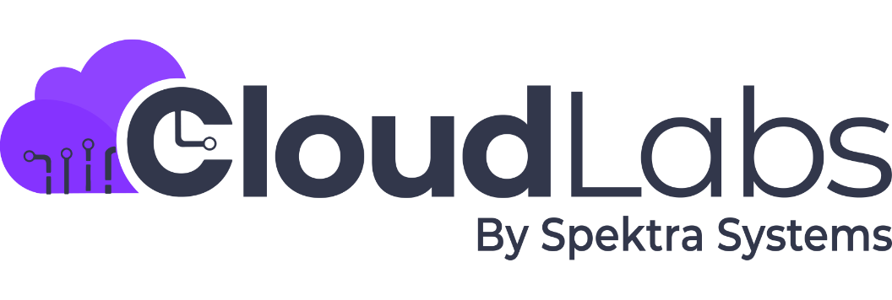
Let's do Hands-On Labs
Powered by:

Slide 28
Lab Objectives
In this hands-on lab, you will learn to create and use AI agents with the Microsoft Agent Framework and Microsoft Foundry. You'll start by building a simple chat agent that can understand and respond to basic requests, then connect it to external tools for more complex tasks. Next, you'll explore multi-agent workflows where specialized agents collaborate or hand off tasks dynamically and implement human-in-the-loop steps for safe decision-making on high-risk actions. By the end, you'll be able to design intelligent, flexible AI systems that combine automated reasoning with human oversight.
Topics Covered:
Getting Started with Agents
Implementing Single and Multi-Agent Workflows using Microsoft Agent Framework
Human-in-the-Loop Workflows Using Microsoft Agent Framework
Lab Guide URL: CloudLabs LabGuide Preview

Slide 29
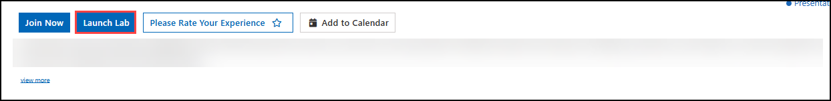
Accessing the Lab
Use the same meeting invite link that you used to join the session by clicking the "Attend Event > Join Now" button.
To access your hands-on lab environment, click the "Launch Lab" button.
Upon clicking "Launch Lab" your lab environment will open in a new browser tab.
If your browser blocks pop-ups, the lab environment may not appear. In such cases, disable the pop-up blocker and try launching the lab again.
Disconnect from any VPNs, since they might interfere with RDP traffic.
Refer to RDP: Known Functionality Issues | CloudLabs Documentation for more VM RDP related issues.

Slide 30
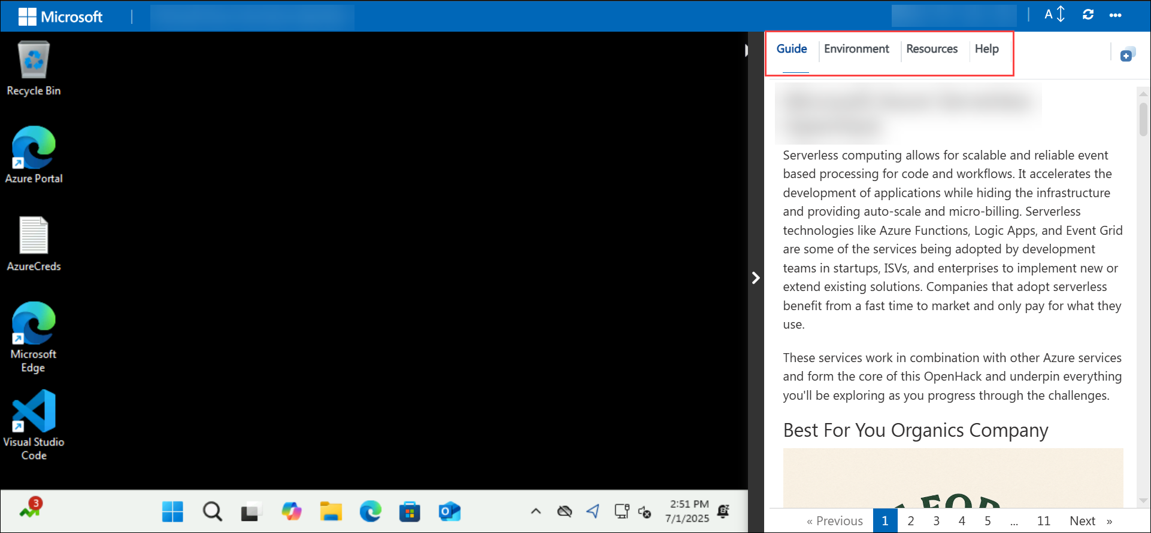
Launching the Lab
Once provisioning is complete, detailed step-by-step instructions will be available on the "Guide" tab within your integrated lab environment.
You can find your login credentials under the "Environment" tab.

Slide 31
Hands-on Labs
Lab 1: Getting Started with Agents (90 mins)
Exercise 01: Getting Started with Agents
Lab 2: Implementing Single and Multi-Agent Workflows using Microsoft Agent Framework (60 mins)
Exercise 01: Creating a Single-Agent Workflow with Tool Integration
Exercise 02: Multi-Agent Workflow Design
Lab 3: Human-in-the-Loop Workflows Using Microsoft Agent Framework (60 mins)
Exercise 01: Implementing Human-in-the-Loop AI Workflows with Microsoft Agent Framework

Slide 32
Questions?

Slide 33
Additional Resources
What is Microsoft Foundry? - Microsoft Foundry | Microsoft Learn
Microsoft Foundry Models overview (classic) - Microsoft Foundry (classic) | Microsoft Learn
Microsoft Agent Framework Overview | Microsoft Learn
Microsoft Agent Framework Workflows | Microsoft Learn
Microsoft Agent Framework Workflows - Human-in-the-loop (HITL) | Microsoft Learn
Using MCP Tools | Microsoft Learn

Slide 34
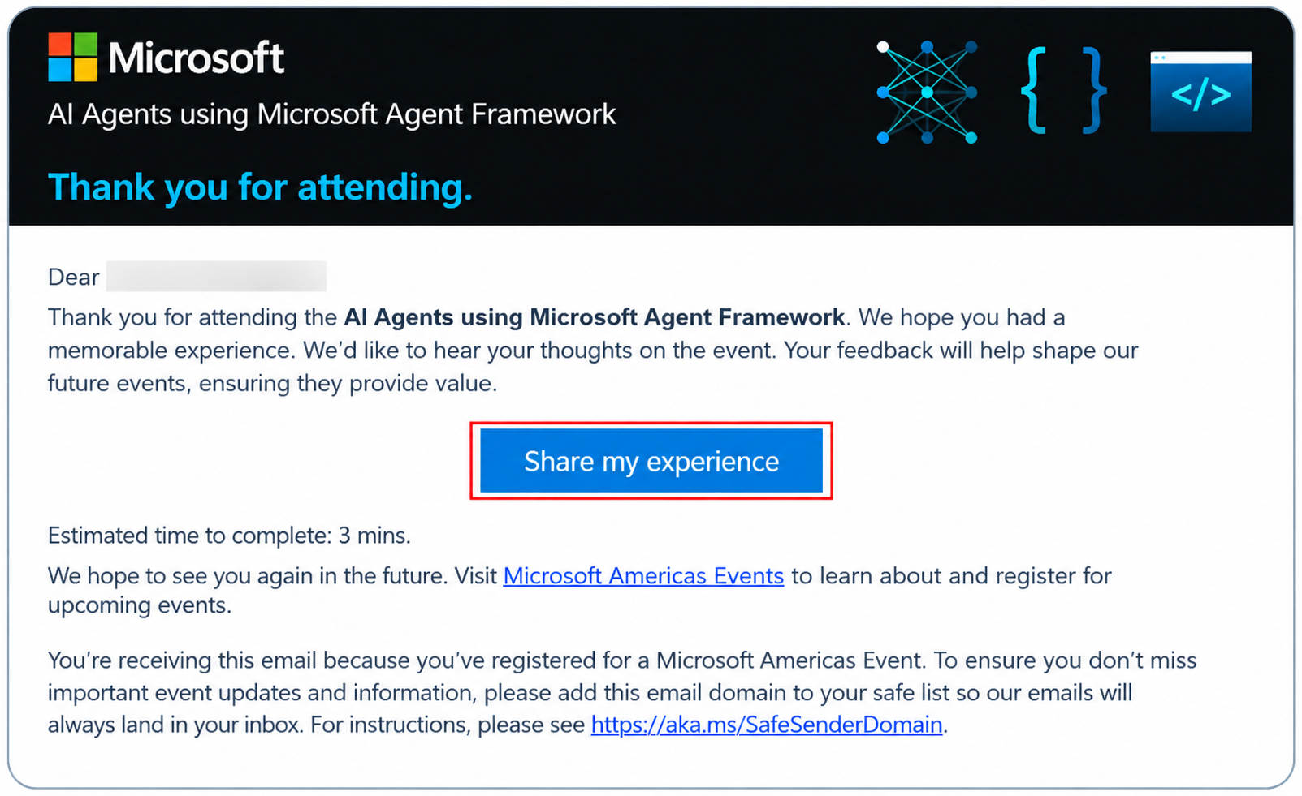
Thank you!
We hope you had a great experience.
We kindly request you to fill out the feedback form that you will receive in the thank you email after the event.
Your feedback is valuable and will help us improve future events.
You can also check our upcoming sessions at
workshops.microsoft.com
Notes:
Updated the thankyou image with Lab Name

